Slide 1
SS G515 - Data Warehousing Dimensional Modeling
Dr. Yashvardhan Sharma
Assistant Professor, CS & IS Dept.
BITS-Pilani

Slide 2
Data Warehouse: Design Steps
Step 1: Identify the Business Process
Step 2: Declare the Grain
Step 3: Identify the Dimensions
Step 4: Identify the Facts

Slide 3
Modeling Design Process
Identify the Business Process
Source of “measurements”
Identify the Grain
What does 1 row in the fact table represent or mean?
Identify the Dimensions
Descriptive context, true to the grain
Identify the Facts
Numeric additive measurements, true to the grain

Slide 4
Step 1 - Identify the Business Process
This is a business activity typically tied to a source system.
Not to be confused with a business department or function. An Orders dimensional model should support the activities of both Sales and Marketing.
“If we establish departmentally bound dimensional models, we’ll inevitably duplicate data with different labels and terminology.”

Slide 5
Step 2 - Identify the Grain
The level of detail associated with the fact table measurements.
A critical step necessary before steps 3 and 4.
Preferably it should be at the most atomic level possible.
“How do you describe a single row in the fact table?”

Slide 6
Step 3 - Identify the Dimensions
The list of all the discrete, text-like attributes that emanate from the fact table.
They are the “by” words used to describe the requirements.
Each dimension could be though of as an analytical “entry point” to the facts.
“How do business people describe the data that results from the business process?”

Slide 7
Step 4 - Identify the Facts
Must be true to the grain defined in step 2.
Typical facts are numeric additive figures.
Facts that belong to a different grain belong in a separate fact table.
Facts are determined by answering the question, “What are we measuring?”
Percentages and ratios, such as gross margin, are non-additive. The numerator and denominator should be stored in the fact table.

Slide 8
Grocery Store: The Universal Example
The Scenario:
Chain of 100 Grocery Stores
60000 individual products in each store
10000 of these products sold on any given day(average)
3 year data

Slide 9
Grocery Store DW
Step 1: Sales Business Process
Step 2: Daily Grain
A word about GRANULARITY
Temp sensor data: per ms, sec, min, hr?
Size of the DW is governed by granularity
Daily grain (club products sold on a day for each store) Aggregated data
Receipt line Grain (each line in the receipt is recorded – finest grain data)

Slide 10
Grocery Store: DW Size Estimate
Daily Grain
Size of Fact Table
= 100*10000*3*365
= 1095 million records
4 facts & 4 dimensions (48 bytes)
Fact size: 8 bytes, dimension size: 4 bytes
1095 m * 48 bytes = 52560 m bytes
i.e. ~ 50 GB

Slide 11
Data Cube
Location
Goa
Dubai
Dimensions:
Time, Product, Location
Attributes:
Product (upc, price, …)
Location…
…
Hierarchies:
Product → Brand → …
Day → Week → Quarter
City → Region → Country
Pilani
Juice
Milk
Coke
Cream
Soap
Bread
10
34
56
32
12
56
Product
roll-up to week
M T W Th F S S
Time
56 units of bread sold in Pilani on M

Slide 12
To Meet the Requirements within DW
The data is organised differently, i.e. “multidimensional”
– star-joins schemas
– snowflake schemas
• The data is viewed differently
• The data is stored differently
– vector (array) storage
The data is indexed differently
– bitmap indexes
– join indexes

Slide 13
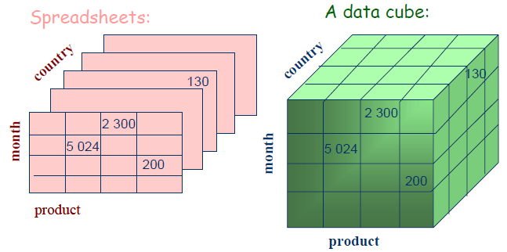
From Spreadsheets to Data Cubes

Slide 14
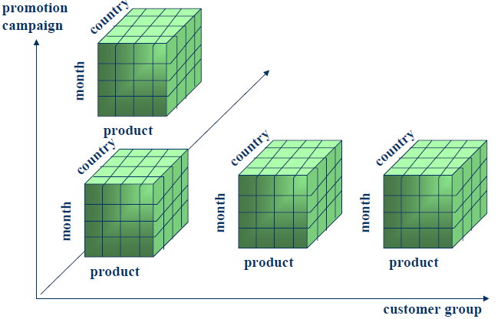
“Multidimensional” view of the data

Slide 15
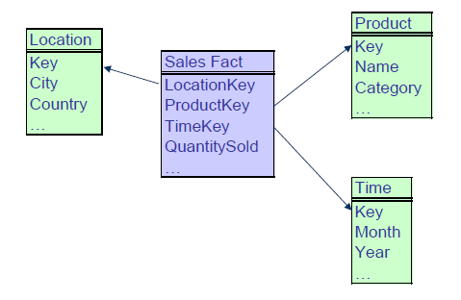
Example - Star-Join Schema

Slide 16
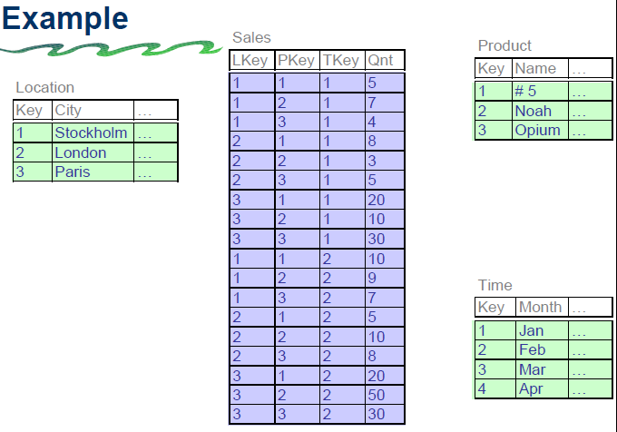

Slide 17
Star-Join Schema
• A single fact table and a single table for each dimension
• Every fact points to one tuple in each of the dimensions and has additional attributes
• The fact table is highly normalised, whereas the dimension tables not normalised.
• Dimensions does not capture hierarchies directly
• Generated keys are used for performance and maintenance reasons
• Fact constellation: Multiple Fact tables that share
many dimension tables

Slide 18
Snowflake Schema
Represent dimensional hierarchy directly by normalizing the dimension tables
• Save storage
• Reduces the effectiveness of browsing

Slide 19
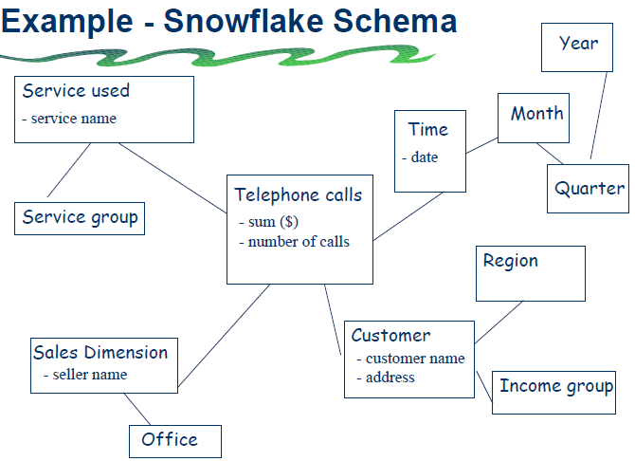

Slide 20
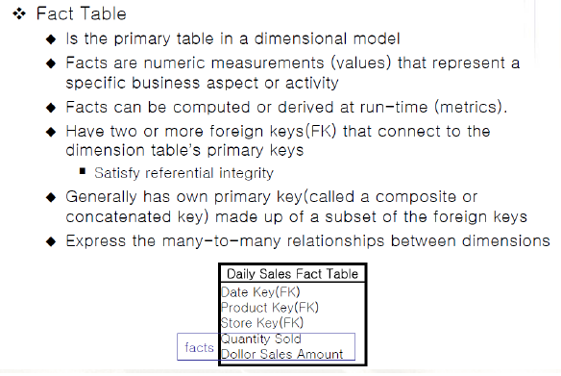
Dimensional modeling vocabulary

Slide 21
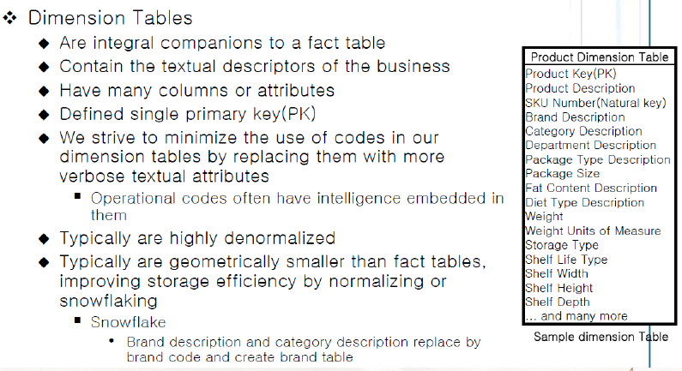
Dimensional modeling vocabulary

Slide 22
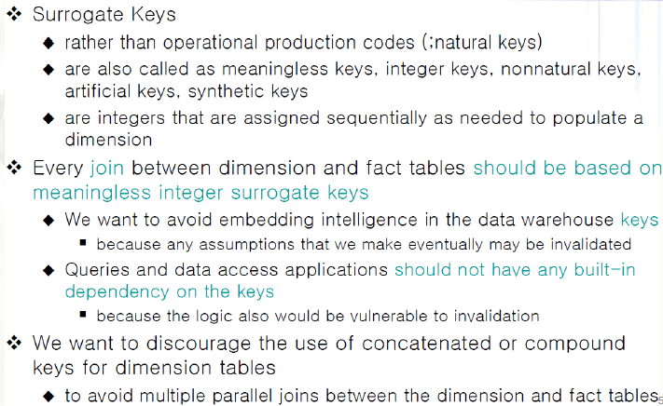
Dimensional modeling vocabulary

Slide 23
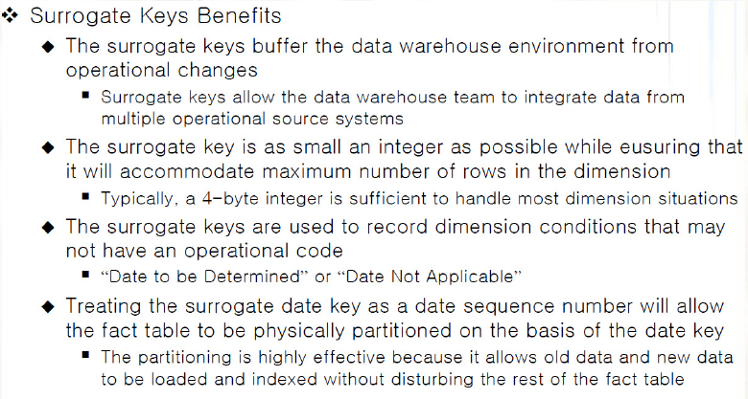
Dimensional modeling vocabulary

Slide 24
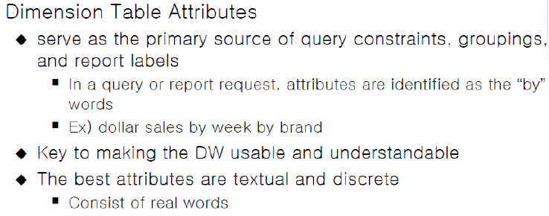
Dimensional modeling vocabulary

Slide 25
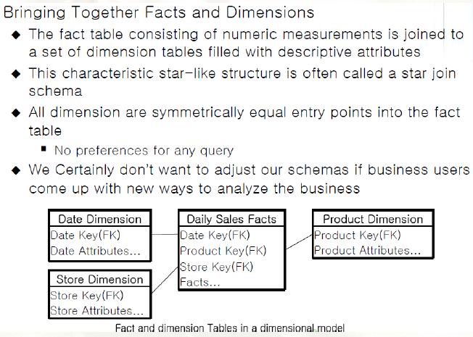
Dimensional modeling vocabulary

Slide 26
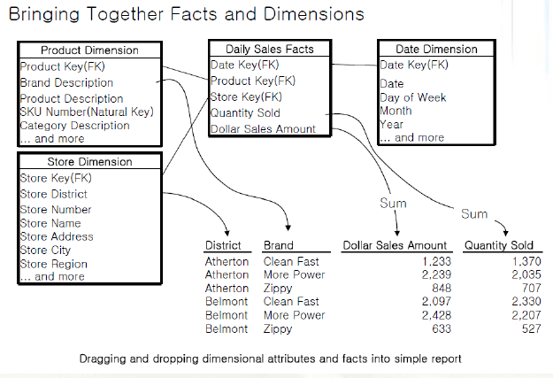
Dimensional modeling vocabulary

Slide 27
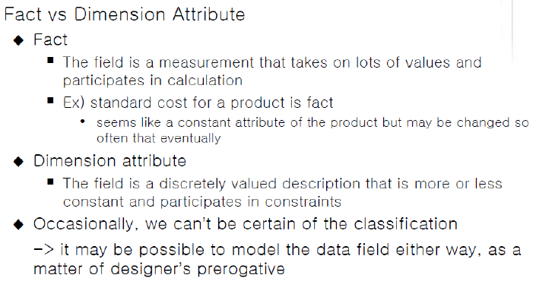
Dimensional modeling vocabulary

Slide 28
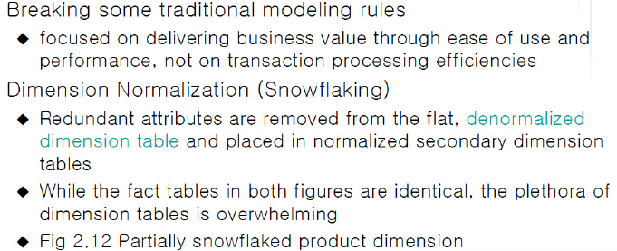
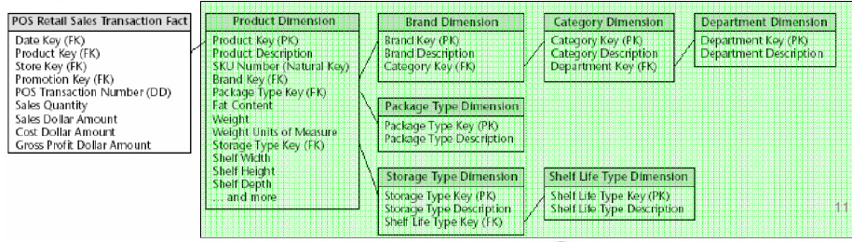
Resisting Comfort Zone Urges

Slide 29
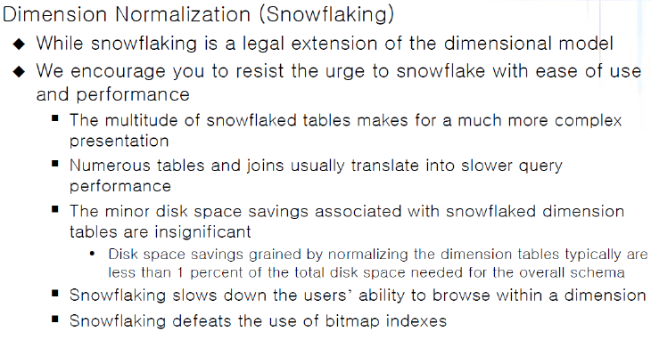
Resisting Comfort Zone Urges

Slide 30
Factless fact tables
• Some fact tables quite simply have no measured facts!
• Are useful to describe events and coverage, i.e. the tables contain information that something has/has not happened.
• Often used to represent many-to-many relationships
• The only thing they contain is a concatenated key, they do still however represent a focal event which is identified by the combination of conditions referenced in the dimension tables
• There are two main types of factless fact tables:
– event tracking tables
– coverage tables

Slide 31
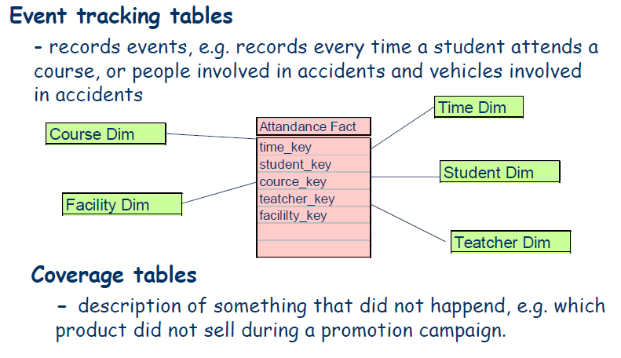
Factless fact tables

